Slide 1
Lecture 9
D&D Chapter 10 Polymorphism and Interfaces

Slide 2
Goals
By the end of this lesson, you should
Know how to implement and use interfaces to achieve polymorphism
Interface: definition ‘the point where two things meet and interact’
In programming, an interface defines a set of methods and in some cases data that an object will provide such that other objects can interact with it.
Polymorphism: definition ‘many forms’
In programming, polymorphism means that the same method call may do different things depending on the exact class of the object on which the call is made

Slide 3
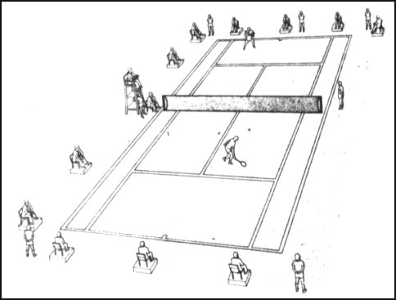
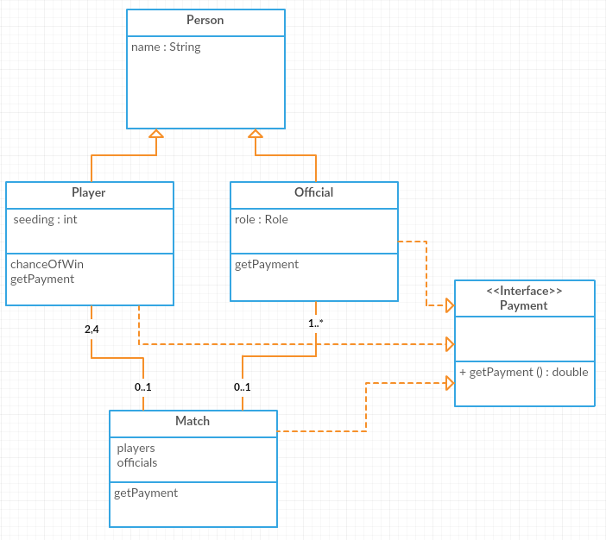
Tennis Tournament
Class diagram
Interfaces
Abstract classes
Implementation
Summary

Slide 4
Tennis tournament
Class diagram
Interfaces
Abstract classes
Implementation
Summary
We now have a class for a match.
Match is not a super or subclass.
The relationship between match and players and officials is has-a.
A match has-a players (cardinality is 2, 4)
A match has-a official(s)
We also have an interface called Payment.
Player, Official and Match all must implement the method(s) in this interface.
Currently there is just one method, getPayment().
A class can implement multiple interfaces. This “multiple inheritance” is one of Java’s ways to achieve polymorphism.

Slide 5
Payment interface
Add a file of type Interface to your project with name Payment.
The interface starts with a declaration a bit like a class declaration except in has the keyword interface after the public (in place of class)
//Payment.java (interface)
public interface Payment {
double getPayment();
}
In the body of the interface it has the signatures of the methods the interface contains – note methods can be overloaded etc. But remember that all the methods in the interface must be implemented by any class that implements the interface (sometimes they can be empty)
Class diagram
Interfaces
Abstract classes
Implementation
Summary

Slide 6
More on interfaces
Interfaces can only contain method declarations, and only with the method signature. No method bodies!
public interface Payment {
double getPayment();
}
If the methods of the interface are to have parameters, then these must be declared, too:
public interface IEat {
void eat(Food kai);
}
The name of the parameters does not matter, only the type does – the implementations can choose different names.
Interfaces can inherit from multiple other interfaces:
public interface IParty extends IEat, IDrink {
void cheer();
}
Any class implementing IParty must implement eat()!
Class diagram
Interfaces
Abstract classes
Implementation
Summary

Slide 7
Person (abstract class)
Class diagram
Interfaces
Abstract classes
Implementation
Summary
// Person.java
public abstract class Person {
protected String name;
// constructors
protected Person () {}
protected Person (String name){
this.name = name;
}
// gets and sets
public void setName(String name){
this.name = name;
}
public String getName(){
return name;
}
//general methods.
}
This class declaration has abstract added to it – this means you cannot instantiate objects of type Person. It’s a good idea to make a class abstract if it is simply a building block. Or, more fashionable, make it an interface.

Slide 8
Player – with payment
//Player.java
public class Player extends Person implements Payment {
……..
//methods
@Override
public String toString() {
return "Player: " + name + ", Seeding " + seeding + " Payment " + getPayment();
}
public double getPayment() {
double payment;
payment = (1010 - seeding * 10) * 500;
return payment;
}
}
Class diagram
Interfaces
Abstract classes
Implementation
Summary
Player extends Person and implements Payment
It has two new methods:
toString() overrides Object.toString(). All classes are automatically subclasses of Object and therefore have Object.toString() - @Overrides is a directive to the compiler so it can check you have the declaration matching – many classes have a toString() that returns the basic status of the object.
getPayment() implements the getPayment() method required by the interface

Slide 9
Official – with payment
public class Official extends Person implements Payment{
……..
//methods
@Override
public String toString() {
return "Official: " + name + ", Role: " + getRole() + " Payment " + getPayment();
}
public double getPayment() {
double payment;
if (role == Roles.UMPIRE)
payment = 10000;
else if (role == Roles.LINEJUDGE)
payment = 2000;
else if (role == Roles.BALLKID)
payment = 200;
else
payment = 0;
return payment;
}
Class diagram
Interfaces
Abstract classes
Implementation
Summary
Official extends Person and implements Payment
It has two new methods
toString()
getPayment() implements the getPayment() method required by the interface – payments vary by role.

Slide 10
Match – new class
// Match.java
import java.util.ArrayList;
public class Match implements Payment {
ArrayList <Person> participants = new ArrayList<Person>();
//constructors
public Match() {}
public Match(Person ... people) {
… see next slide
}
//methods
public String toString() {
…… see following slide
}
public double getPayment() {
return 1000;
}
}
Class diagram
Interfaces
Abstract classes
Implementation
Summary

Slide 11
Match – constructor
// Match.java
public Match(Person ... people) {
for (Person p: people) {
participants.add(p);
}
}
This constructor takes an arbitrary number of Person objects – the … means we don’t have to specify how many. This is known as a variable arity parameter.
They can be of type Player or Official - as these are both inherited types of Person, the parameter can handle them.
To the method, people is an array of the type specified with the name specified (as if we had written Person[] people = {…,…})
The for adds them all to the ArrayList – again the ArrayList can handle either type of derived class.
Note: We’ve already used a method with a variable arity parameter: System.out.printf()
Class diagram
Interfaces
Abstract classes
Implementation
Summary

Slide 12
Match – toString()
// Match.java
public String toString() {
String concatenator = "Match \n";
for (Person p: participants) {
concatenator += " " + p.toString() + " Payment " + getPayment() + "\n";
}
return concatenator;
}
This method demonstrates the power of inheritance. The objects of type Player or Official can be held in an ArrayList collection together and processed together.
If necessary, you can find out the type of a particular object in two different ways:
if (myObjects.get(0) instanceof Player)
System.out.println("The object is a Player");
if (myObjects.get(0).getClass() == Player.class)
System.out.println("The object is a Player");
Class diagram
Interfaces
Abstract classes
Implementation
Summary

Slide 13
Polymorphism test
Class diagram
Interfaces
Abstract classes
Implementation
Summary
import java.util.ArrayList;
public class PolymorphismTest {
public static void main(String[] args) {
ArrayList<Payment> myObjects = new ArrayList<Payment>();
Player player1 = new Player();
player1.name = "Serena Williams";
player1.setSeeding(2);
Player player2 = new Player("Roger Federer",17);
Official official1 = new Official("Kader Nouni", "umpire");
Official official2 = new Official("Jilly BallGirl", "BallGirl");
Match match = new Match(player1, player2, official1, official2);
// demonstrate polymorphism with an interface
… see next slide
}
}

Slide 14
Polymorphism test
import java.util.ArrayList;
public class PolymorphismTest {
public static void main(String[] args) {
ArrayList<Payment> myObjects =
new ArrayList<Payment>();
…..
// demonstrate polymorphism with an interface
myObjects.add(player1);
myObjects.add(player2);
myObjects.add(official1);
myObjects.add(official2);
myObjects.add(match);
for (Object o: myObjects) {
System.out.println(o.toString());
}
Class diagram
Interfaces
Abstract classes
Implementation
Summary
This ArrayList holds objects of type Payment – our interface.
Any objects whose classes implement the interface can be added to the ArrayList. This means that they must implement the required methods, so the methods can be accessed.

Slide 15
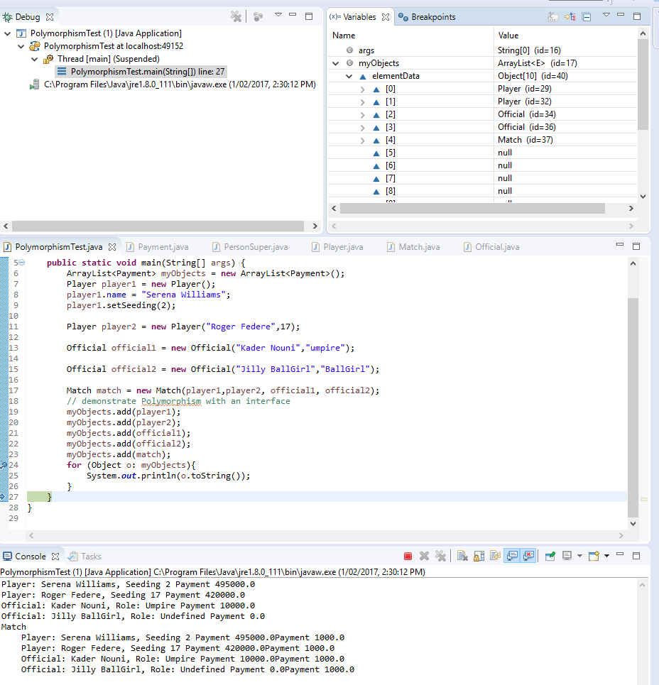
Debug
Class diagram
Interfaces
Abstract classes
Implementation
Summary

Slide 16
What do we know
Class diagram
Interfaces
Abstract classes
Implementation
Summary
The use of interfaces is one way of achieving polymorphism in Java
We define each interface in a separate file, similar to a class declaration (the file even has a .java extension)
It declares the method signatures of the methods that a class with the interface must implement, but does not specify how they are implemented.
Interfaces don’t contain variables or any other code.
The interface is now another type available to the program
A class can implement more than one interface. When implementing the interface, it must implement all methods specified in the interface.
Variables or collections (ArrayLists) can be created for any interface type.
Such a collection can then be iterated over etc.
OO stuff
The type of an object can be determined at runtime using the instanceof keyword or object.getClass() == classname.class
A class can be declared as abstract. This means it cannot be instantiated itself, but used as a superclass only. Like interfaces, abstract classes can declare methods without implementing them. Non-abstract subclasses must then implement these methods.

Slide 17
Resources
Class diagram
Interfaces
Abstract classes
Implementation
Summary
D&D chapter 10
https://docs.oracle.com/javase/tutorial/java/IandI/createinterface.html
Homework
D&D chapter 10
Play with the sample program. Add toString() to the interface
Call the Match() constructor with different numbers of arguments.

Slide 18
Next Lecture
Graphics (subsections in chapters 1-10)

